Slide 1
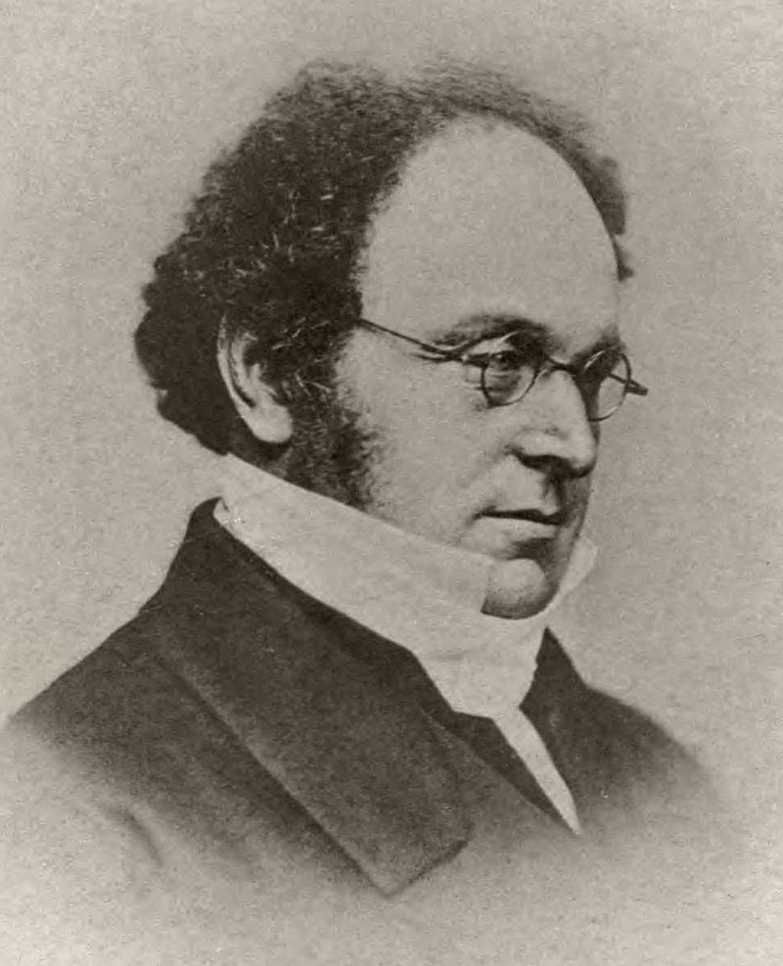
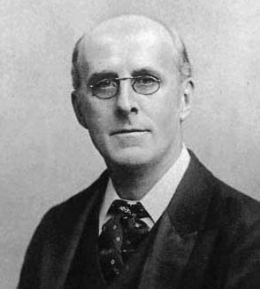
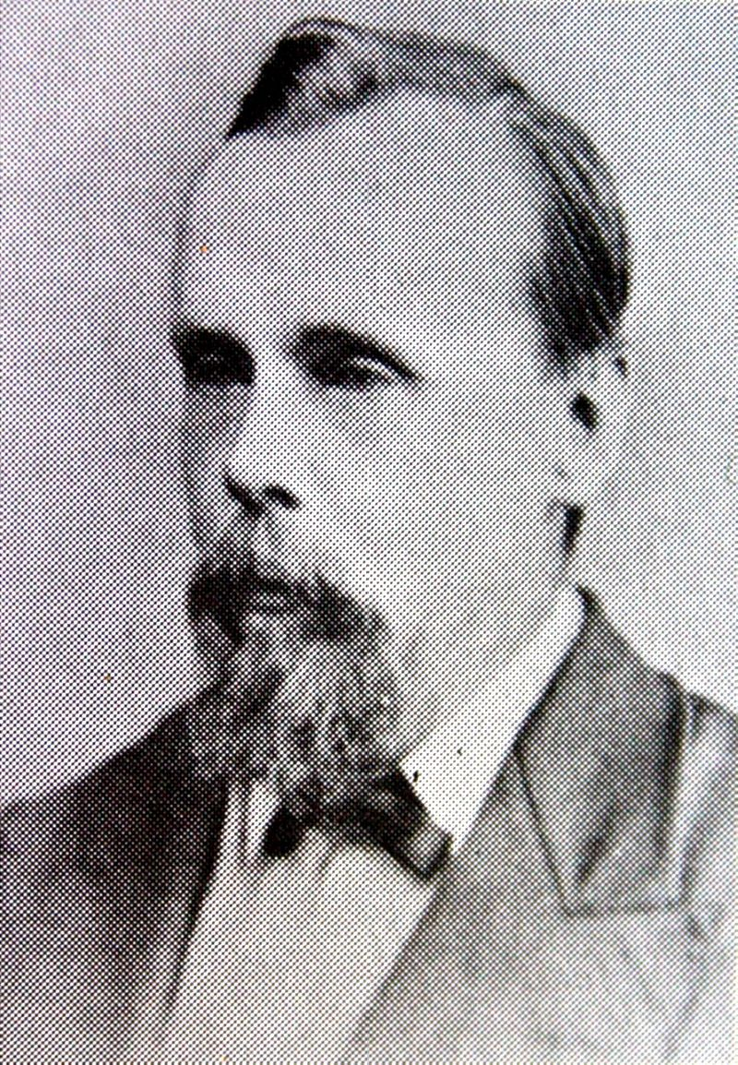
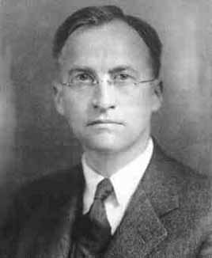
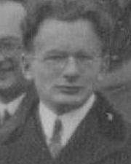
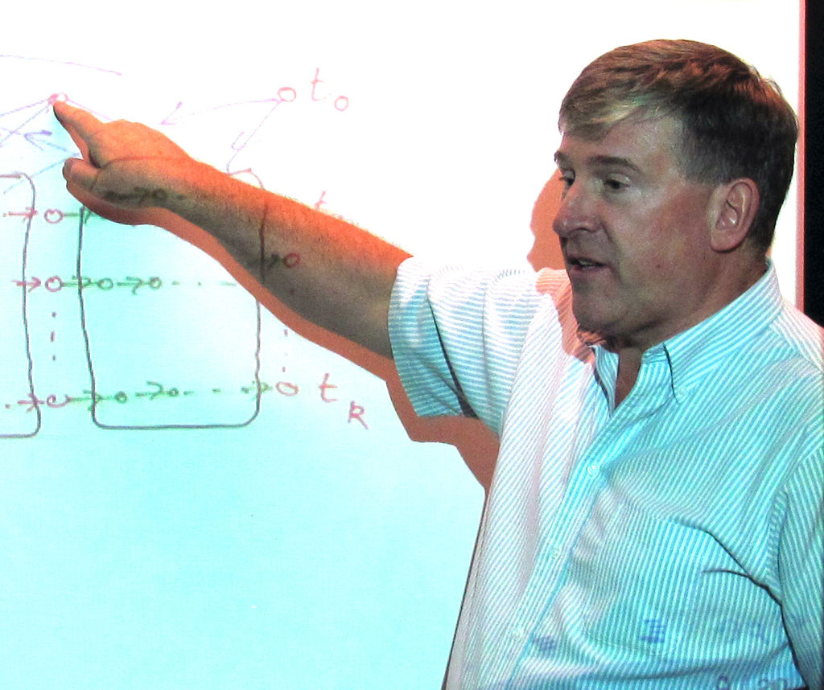
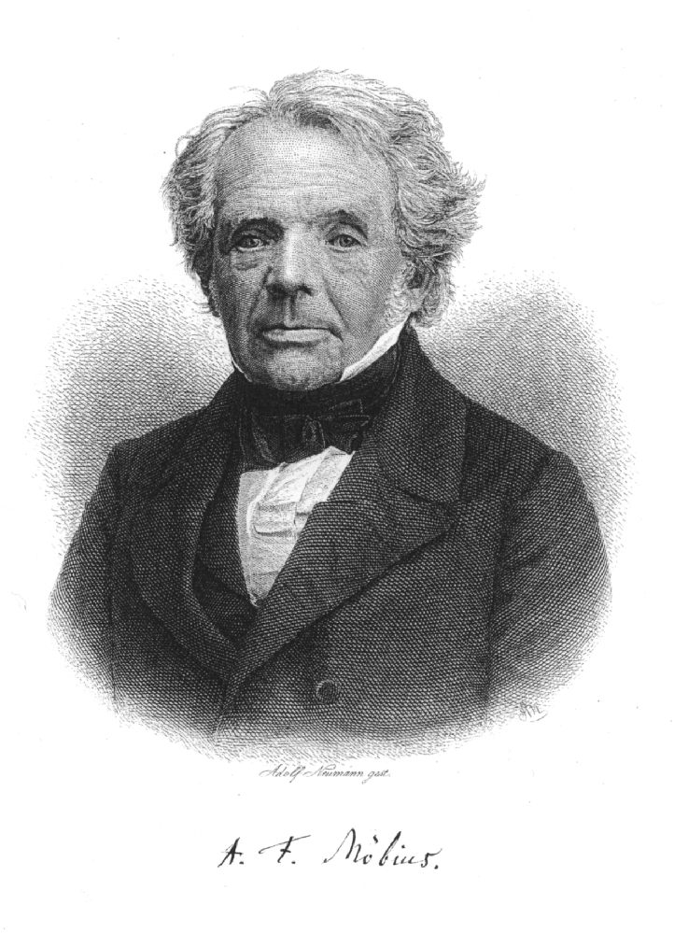
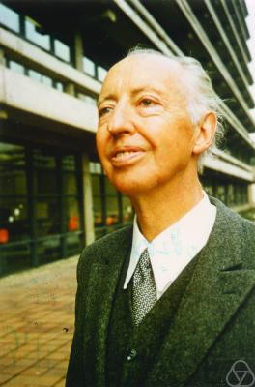
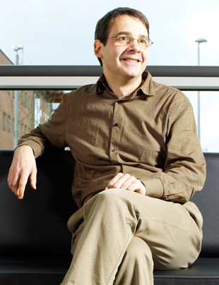
Quatre couleurs sufficent

Slide 2
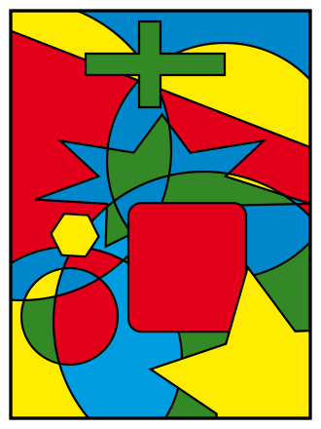
The start : maps

Slide 3
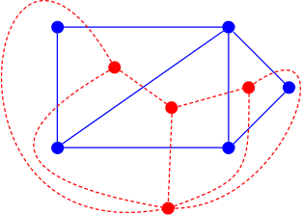
Step 1 : from maps to graphs
Dual graph

Slide 4
Maximal planar graphs
Planar graph is a graph for which there is an embedding in the plane without crossing edges
Maximal = planar graph in which adding any edge will make it non-planar

Slide 5
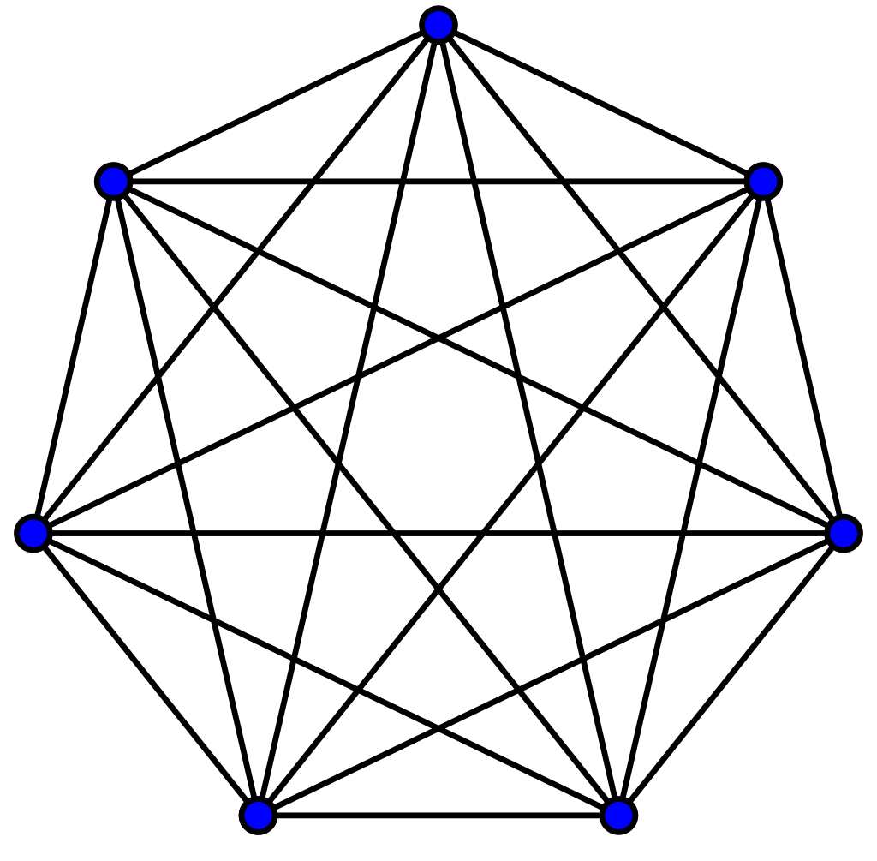
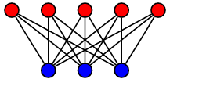
Terminology
Kn is the complete graph on n vertices
Kn,m is the complete “bipartite” graph on n vertices left and m vertices right

Slide 6
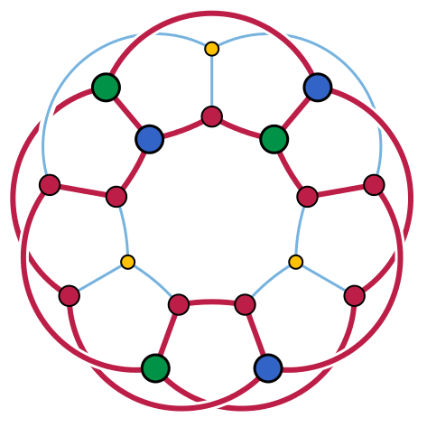
Kuratowski
A finite graph is planar if and only if it does not contain a subgraph that is a subdivision of K₅ or of K_{3,3}

Slide 7
Attacking the problem
Suppose v, e, and f are the number of vertices, edges, and regions (faces).
Since each region is triangular and each edge is shared by two regions, we have that 2e = 3f.
This together with Euler's formula, v − e + f = 2, can be used to show that 6v − 2e = 12

Slide 8

Always at least degree 5
Now, the degree of a vertex is the number of edges abutting it. If v_{n} is the number of vertices of degree n and D is the maximum degree of any vertex,
But since 12 > 0 and 6 − i ≤ 0 for all i ≥ 6, this demonstrates that there is at least one vertex of degree 5 or less.
Vertices
Edges

Slide 9
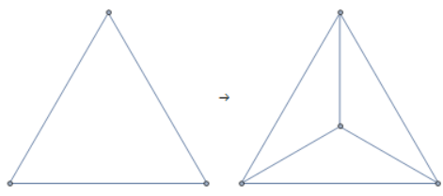
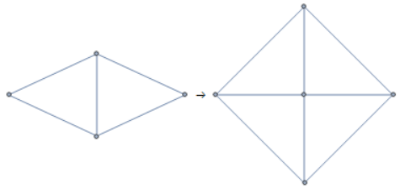
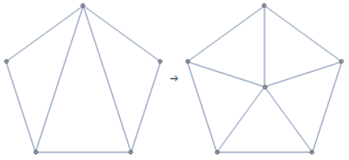
Attack by degree
We could therefore prove the following :

Slide 10
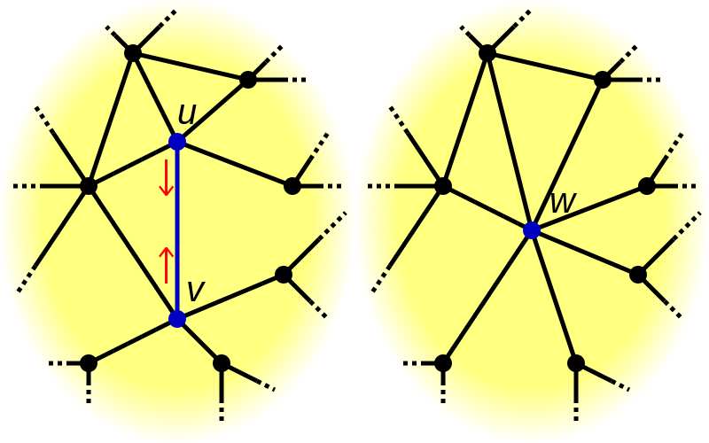
Concept : Deletion / contraction
Notice the following
Number of colorings of graph without edge u<->v =
Number of times u and v have a different color = graph with edge u<->v added
+ Number of times u and v have the same color = graph with vertices u and v “contracted”

Slide 11
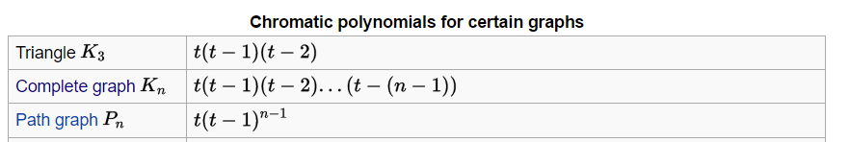
Chromatic polynomial
The chromatic polynomial is a polynomial studied in algebraic graph theory, a branch of mathematics. It counts the number of graph colorings as a function of the number of colors and was originally defined by George David Birkhoff to attack the four color problem.
Example :

Slide 12
Deletion contraction and chromial
Deletion contraction gives a (slow) algorithm to find the chromatic polynomial
At each point we generate 2 graphs so we’re exponential in number of nodes (there are branch and bound strategies)
At each point we can strive for complete graphs or for a spanning tree (Wilf et al)

Slide 13
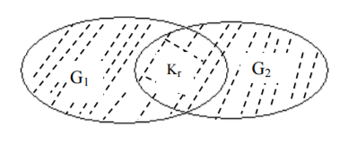

Zykov’s rule
If G = G₁∪ G₂ and G1∩ G₂ = 𝐾_{𝑟} , then
P(G, λ ) =$\frac{\text{P}\text{(}\text{G}\text{1}\text{, }\text{λ}\text{ ) ∗ }\text{P}\text{(}\text{G}\text{2}\text{, }\text{λ}\text{ )}}{\text{P}\text{(}\text{K}\text{r}\text{, }\text{λ}\text{ )}}$

Slide 14

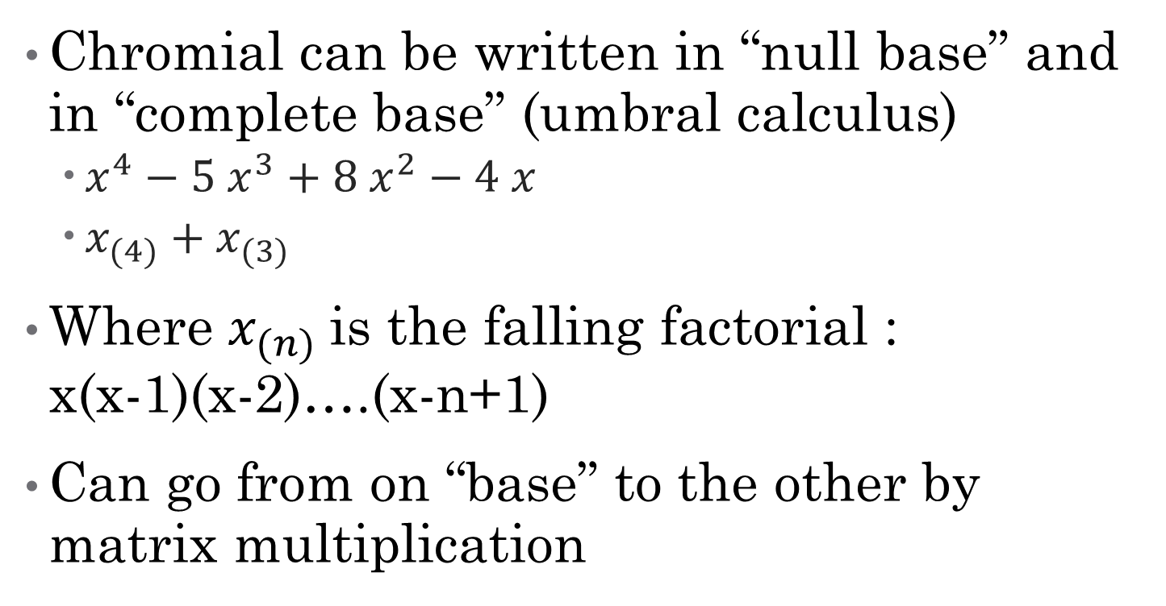
Forms
Chromial can be written in “null base” and in “complete base” (umbral calculus)
$x^{4}−5 x^{3}+8 x^{2}−4 x$
$x_{(4)}+x_{(3)}$
Where $x_{(n)}$is the falling factorial : x(x-1)(x-2)….(x-n+1)
Can go from on “base” to the other by matrix multiplication

Slide 15
Before we “begin”
3 proofs already
1) Appel and Haken 1976 using 1936 unavoidable configurations
2) Robertson, Sanders, Seymour, and Thomas (1997) using same approach and far less unavoidable configurations
3) Georges Gonthier (2005 – Microsoft Research) using coq

Slide 16
Taste of proof : the triangle

Slide 17
Proof for the triangle (trivial)

Slide 18
Proof for the quadrilateral

Slide 19
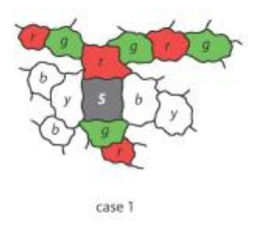
Classical quadrilateral : Kempe chains
We try to have “s” surrounded by at most 3 colors so s itself can be colored using the 4th
Bottom can interchange red and green

Slide 20
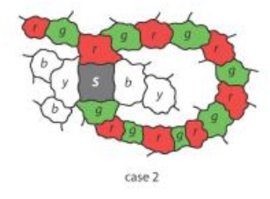
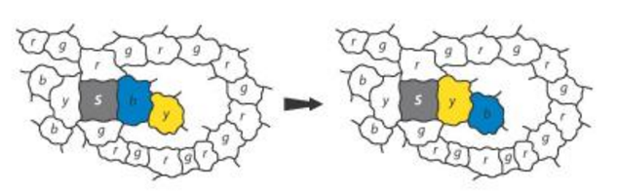
Kempe chain part 2
The first chain blocks the second

Slide 21
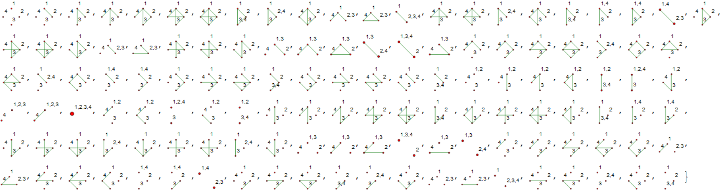
Wvdd part I
“Let’s compute all graphs that come from the quadrilateral by deletion contraction”
Each graph is only a snapshot

Slide 22
Observations : “base”
All 127 graphs can be written as linear combinations of 15 “atom” graphs.
There is more than 1 base :

Slide 23

Inequalities
For some graphs we know they are 4-colorable, for some we can deduce it (because it is the some of 2 4-colorable graphs)
Algorithm : line segment intersections

Slide 24
A deduction

Slide 25
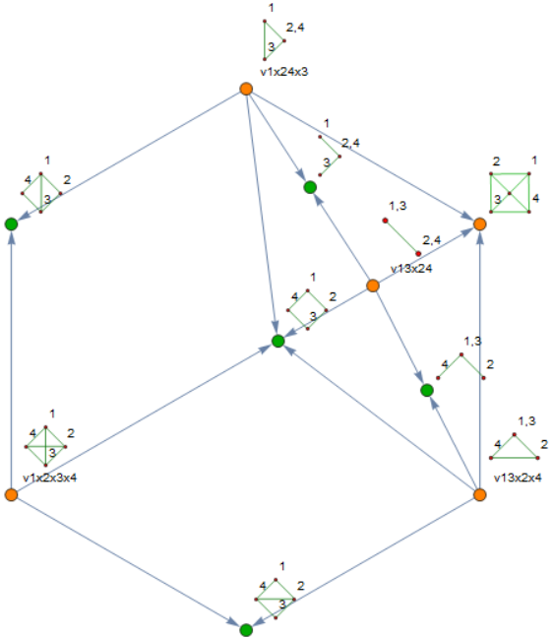
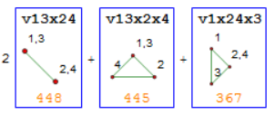

Slide 26
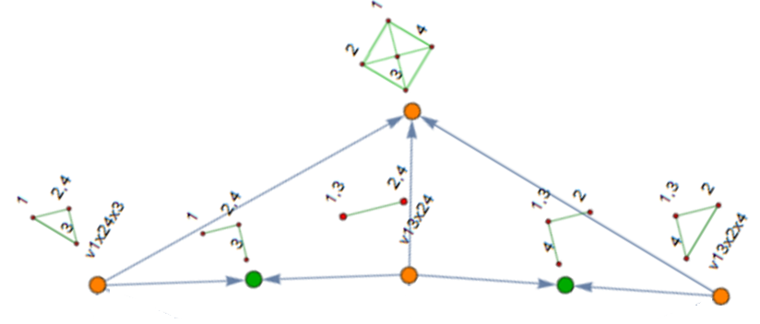
Some focus

Slide 27
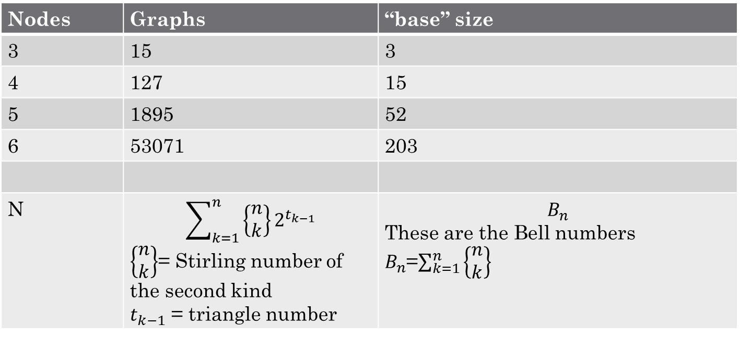
Some counting
Nodes | Graphs | “base” size
3 | 15 | 3
4 | 127 | 15
5 | 1895 | 52
6 | 53071 | 203
N | $$\sum_{k=1}^{n}{\left\{\begin{matrix}n \\ k\end{matrix}\right\}}2^{t_{k−1}}$$ $\left\{\begin{matrix}n \\ k\end{matrix}\right\}$= Stirling number of the second kind $t_{k−1}$ = triangle number | $$B_{n}$$ These are the Bell numbers $B_{n}$=$\sum_{k=1}^{n}{\left\{\begin{matrix}n \\ k\end{matrix}\right\}}$

Slide 28
The pentagon

Slide 29
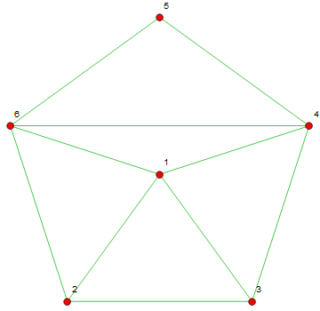
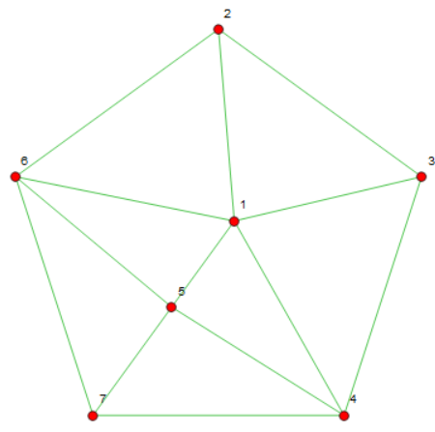
Hopeful:
B43 > 0
Some pentagons are > 0

Slide 30
Kempe chain fails

Slide 31












Derivation

Slide 32
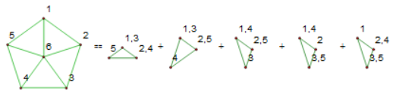
In terms of complete base (only for 4 colours)

Slide 33
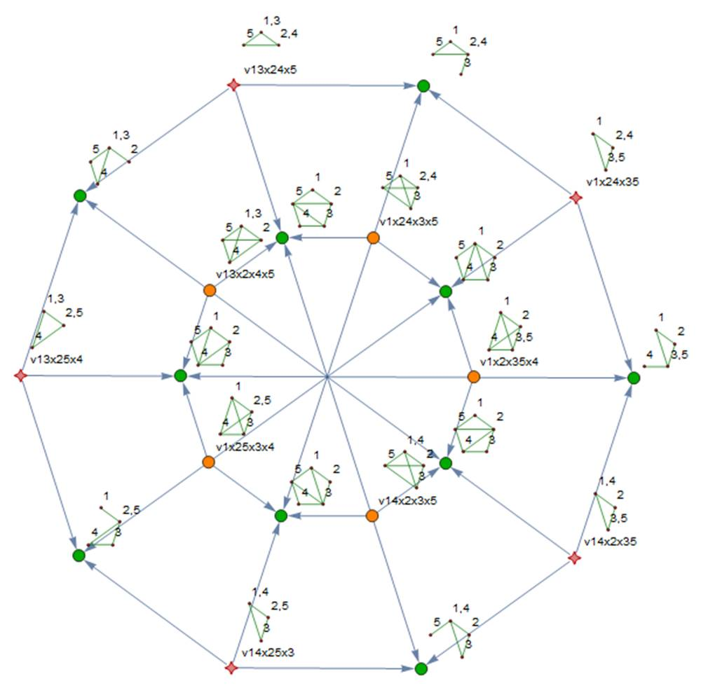

Slide 34
Damn
Setting alfa1 … to zero does NOT cause a contradiction
I have graphs in which at least one of the five contracted triangles is zero (when embedded)

Slide 35
Damn

Slide 36

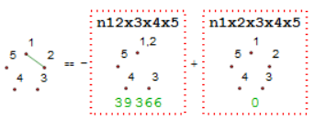
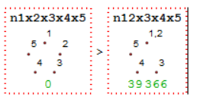
Inequalities
Since > 0
And
We also have

Slide 37
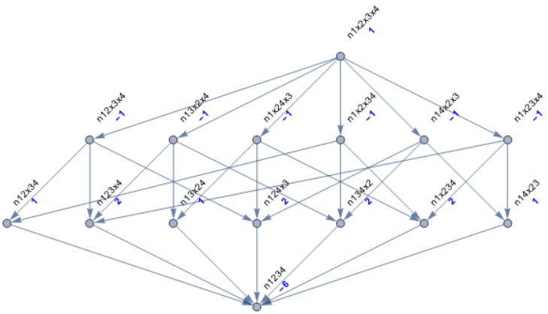
Structure
These inequalities impose a structure on the “atoms” :

Slide 38
Lattices and posets
It turns out that this structure is a lattice
Studying zeta and mobius functions.
Why : Mobius function on bond lattice yields the chromial.

Slide 39


Calculating the Mobius function
x⁴
-1-1-1-1-1-1=-6x³
1+2+1+2+2+2+1=11x²
-6x

Slide 40
Calculating the zeta function
As inverse of Mobius matrix
As MakeOne[Inverse[Identity - adjacency]]

Slide 41
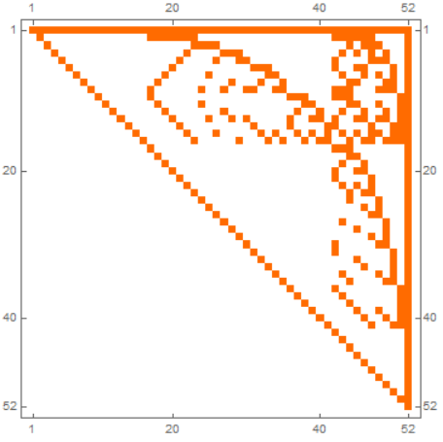
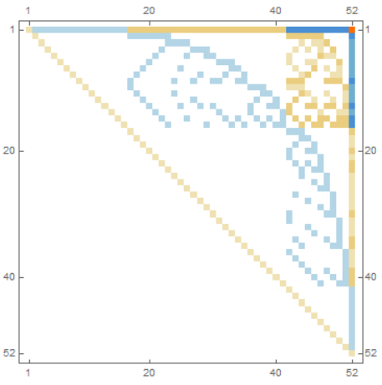
Curiouser and curiouser
Zeta
Mobius

Slide 42
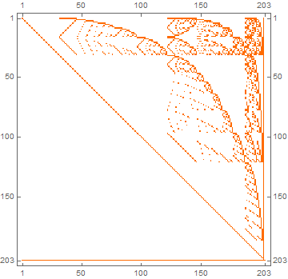
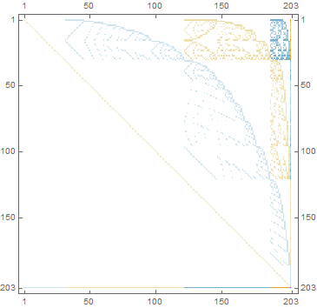
For six nodes

Slide 43
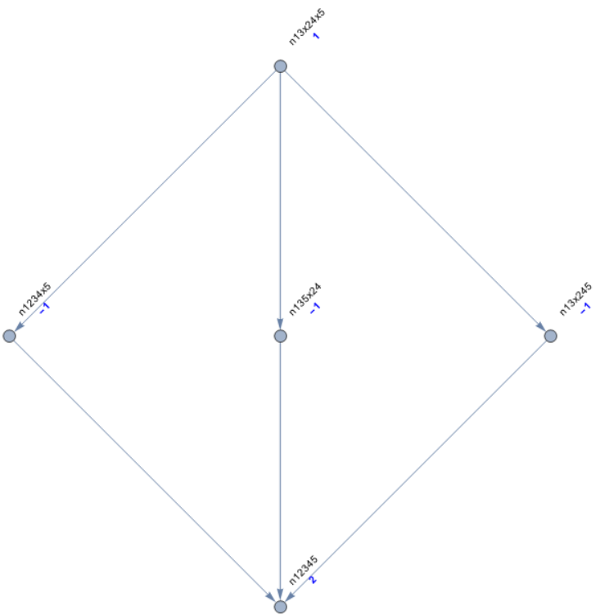
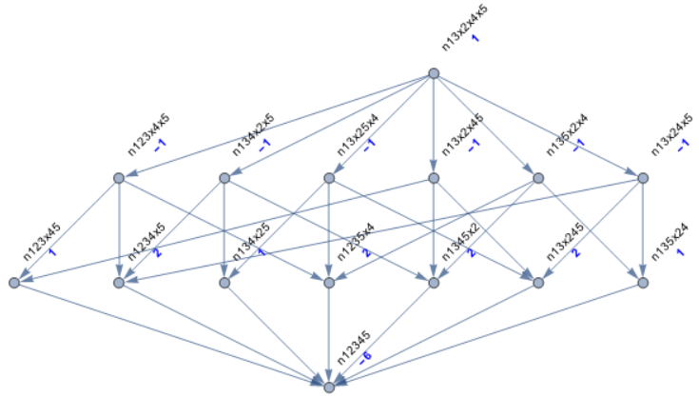
Alfa1 .. Quad1 ..

Slide 44
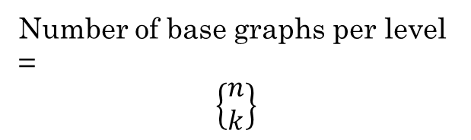
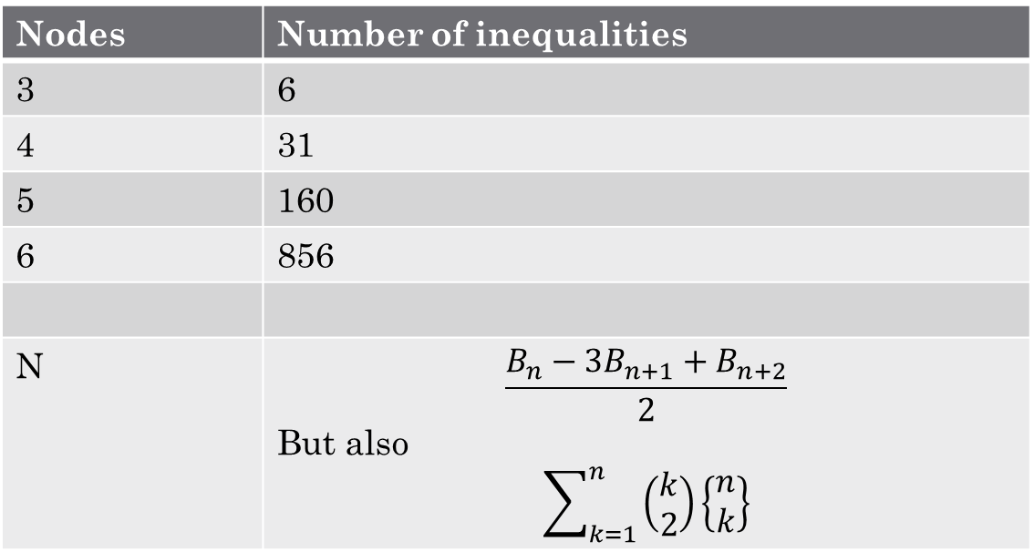
More counting
Nodes | Number of inequalities
3 | 6
4 | 31
5 | 160
6 | 856
N | $$\frac{B_{n}−3B_{n+1}+B_{n+2}}{2}$$ But also $$\sum_{k=1}^{n}{\left(\begin{matrix}k \\ 2\end{matrix}\right)\left\{\begin{matrix}n \\ k\end{matrix}\right\}}$$
Number of base graphs per level =
$$\left\{\begin{matrix}n \\ k\end{matrix}\right\}$$
OEIS A003128
but not for this context

Slide 45
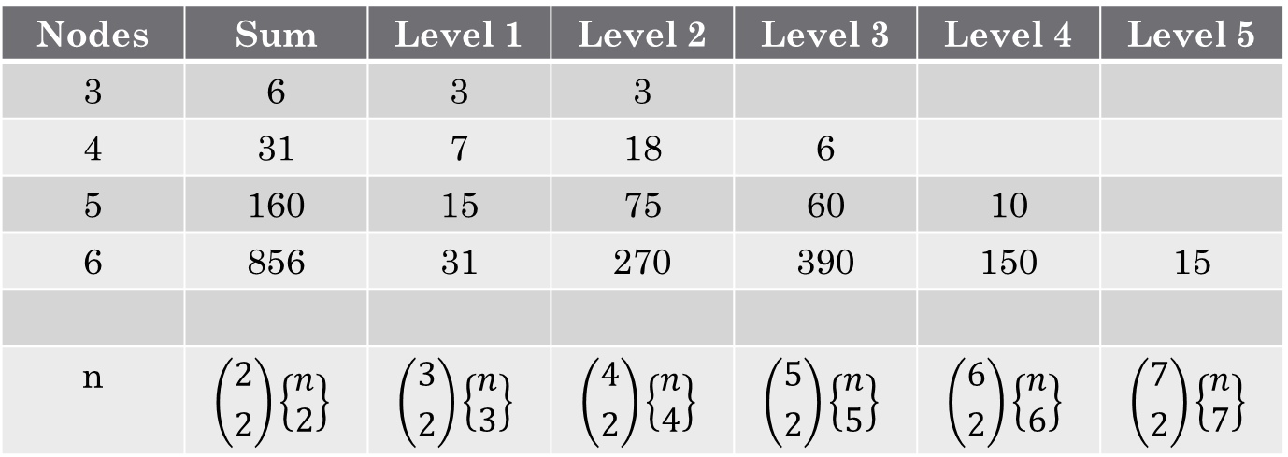
More detail for same
Nodes | Sum | Level 1 | Level 2 | Level 3 | Level 4 | Level 5
3 | 6 | 3 | 3
4 | 31 | 7 | 18 | 6
5 | 160 | 15 | 75 | 60 | 10
6 | 856 | 31 | 270 | 390 | 150 | 15
n | $$\left({2 \atop 2}\right)\left\{\begin{matrix}n \\ 2\end{matrix}\right\}$$ | $$\left({3 \atop 2}\right)\left\{\begin{matrix}n \\ 3\end{matrix}\right\}$$ | $$\left({4 \atop 2}\right)\left\{\begin{matrix}n \\ 4\end{matrix}\right\}$$ | $$\left({5 \atop 2}\right)\left\{\begin{matrix}n \\ 5\end{matrix}\right\}$$ | $$\left({6 \atop 2}\right)\left\{\begin{matrix}n \\ 6\end{matrix}\right\}$$ | $$\left({7 \atop 2}\right)\left\{\begin{matrix}n \\ 7\end{matrix}\right\}$$

Slide 46
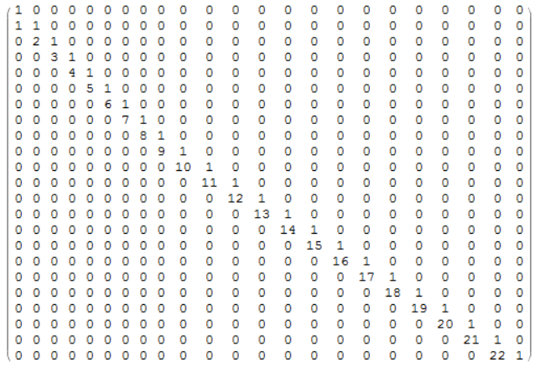
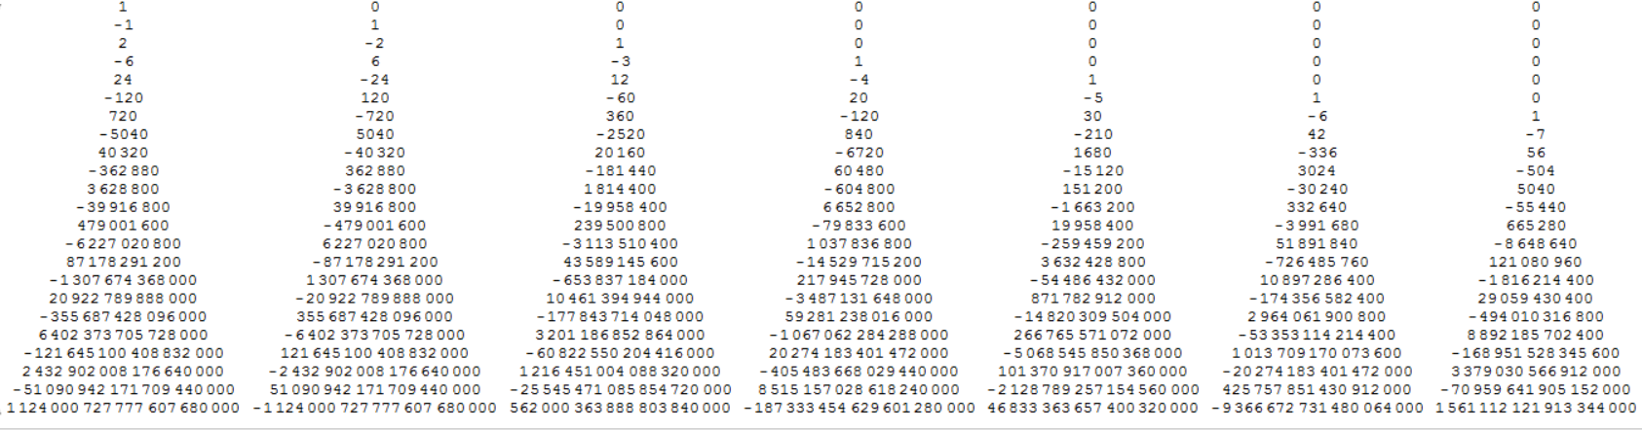
Factoid : more than one umbral notation
From umbral 4 tot umbral 5 through very simple matrices. Inverse matrices are rather complicated – OEIS : restricted Stirling https://oeis.org/A143496

Slide 47
What’s next
Matroids
Why ? They talk about bases in a more abstract way than linear algebra
They seem to be the common ground between linear algebra and graphs.
https://www.youtube.com/playlist?list=PL-XzhVrXIVeSu_b29hbX5xJ0bRThokU8a
Posets/Incidence algebra ?
Recursion in partition
Why is K5,K6 Zero from a Mobius point of view?

Slide 48

Numerology
$\left(1,−4,6,−4,1\right)\left(0,1,4,9,16\right)$ = 0
$\left(1,−4,6,−4,1\right)\left(0,1,8,27,64\right)$ = 0
$\left(1,−4,6,−4,1\right)\left(0,1,16,91,256\right)$ = 24
$$\sum_{k=1}^{n}{\left({n \atop k}\right){(−1)}^{k}k^{m}}=\left\{\begin{aligned}0 if m<n \\ {(−1)}^{n}n! if m=n\end{aligned}\right.$$

